Slide 1
Virtualization and Cloud computing
CS 240: Computing Systems and Concurrency
Lecture 3
Marco Canini
Credits: Y. Agarwal, S. Seshan, CMU 15-440; A. Haeberlen, Z. Ives, Upenn NETS212; UCLouvain INGI2145

Slide 2
Today’s outline
Cloud computing
Virtualization
What’s really cloud computing?

Slide 3
Cloud computing
Computing at scale
The need for scalability; scale of current services
Scaling up: From PCs to data centers
Problems with 'classical' scaling techniques
Utility computing and cloud computing
What are utility computing and cloud computing?
What kinds of clouds exist today?
What kinds of applications run on the cloud?

Slide 4
How many users and objects?
Flickr has > 10 billion photos
Facebook has 2 billion monthly users
Google is serving > 3.5 billion queries/day on more than 130 trillion pages
> 5 billion videos/day watched on YouTube
300 hours of video are uploaded to YouTube every minute!

Slide 5
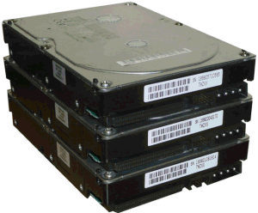
How much data?
Modern applications use massive data:
Rendering 'Avatar' movie required >1 petabyte of storage
CERN's LHC will produce about 15 petabytes of data per year
In 2008, Google processed 20 petabytes per day
Dropbox has > 500 petabytes of user data
Google now designing for 1 exabyte of storage
NSA Utah Data Center is said to have 5 zettabyte (!)
How much is a zettabyte?
1,000,000,000,000,000,000,000 bytes (10²¹)
A stack of 1TB hard disks that is 25,400 km high
25,400 km
Notes:
That’s twice the earth’s diameter!

Slide 6
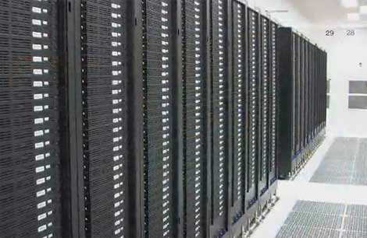
How much computation?
No single computer can process that much data
Need many computers!
How many computers do modern services need?
Facebook is thought to have more than 60,000 servers
1&1 Internet has over 70,000 servers
Akamai has > 95,000 servers in 71 countries
Intel has ~100,000 servers in 97 data centers
Microsoft has > 1 million servers in 2008
Google is thought to have more than 1 million servers, is planning for 10 million (according to Jeff Dean)

Slide 7
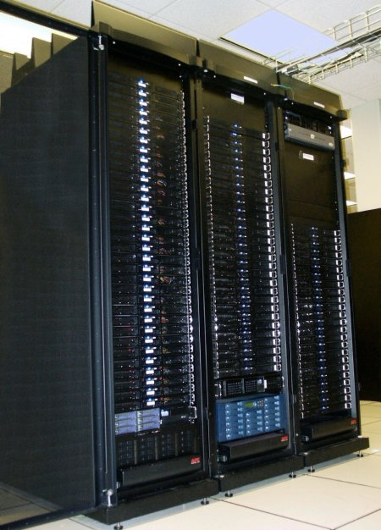
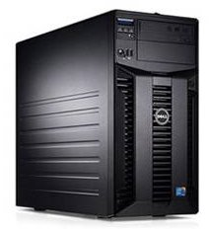
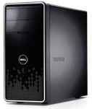
Scaling up
PC
Server
Cluster
What if one computer is not enough?
Buy a bigger (server-class) computer
What if the biggest computer is not enough?
Buy many computers

Slide 8
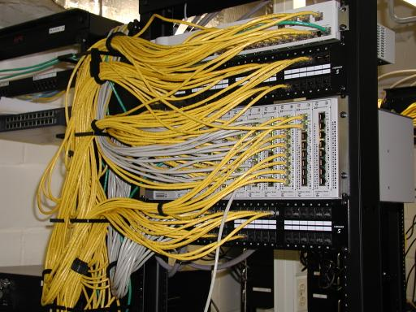
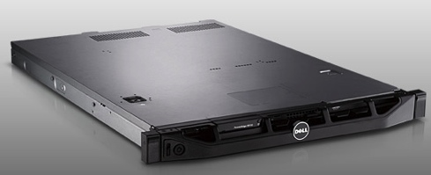
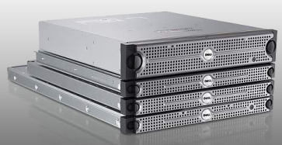
Clusters
Network switch (connects nodes with each other and with other racks)
Rack
Many nodes/blades (often identical)
Storage device(s)
Characteristics of a cluster:
Many similar machines, close interconnection (same room?)
Often special, standardized hardware (racks, blades)
Usually owned and used by a single organization

Slide 9
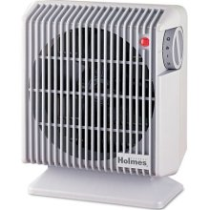
Power and cooling
Clusters need lots of power
Example: 140 Watts per server
Rack with 32 servers: 4.5kW (use special power supply!)
Most of this power is converted into heat
Large clusters need massive cooling
4.5kW is about 3 space heaters
And that's just one rack!

Slide 10
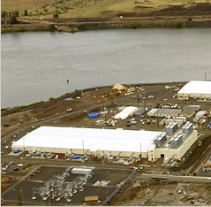
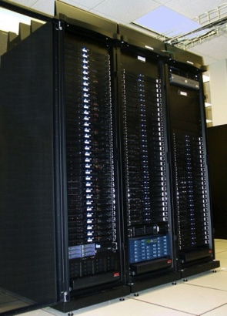
Scaling up
PC
Server
Cluster
Data center
What if your cluster is too big (hot, power hungry) to fit into your office building?
Build a separate building for the cluster
Building can have lots of cooling and power
Result: Data center

Slide 11
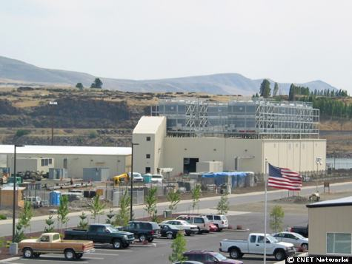
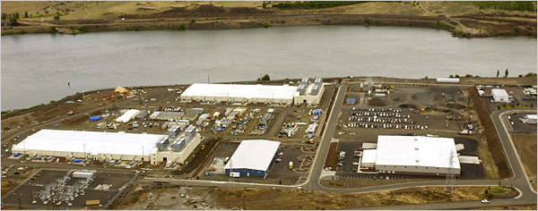
What does a data center look like?
Cooling plant
Data centers (size of a football field)
Google data center in The Dalles, Oregon
A warehouse-sized computer
A single data center can easily contain 10,000 racks with 100 cores in each rack (1,000,000 cores total)

Slide 12
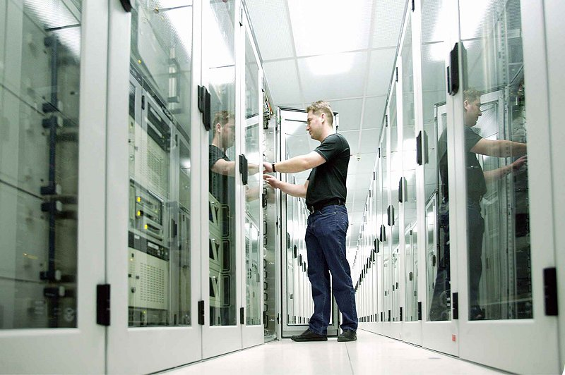
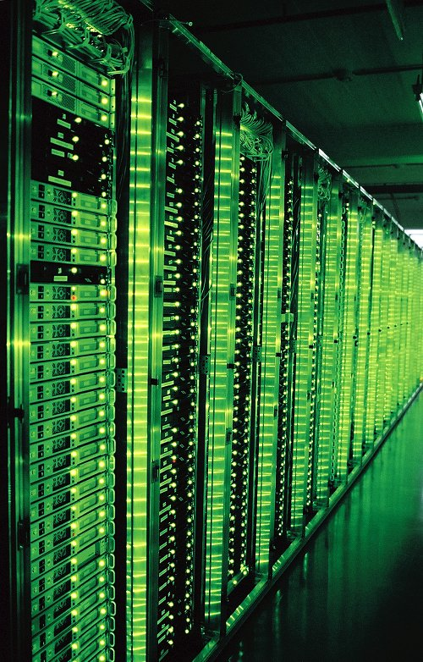
What’s in a data center?
Source: 1&1
Hundreds or thousands of racks

Slide 13
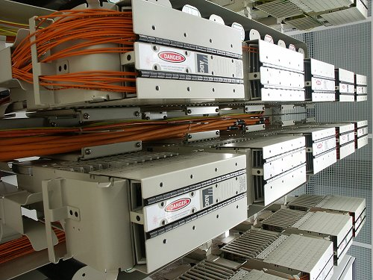
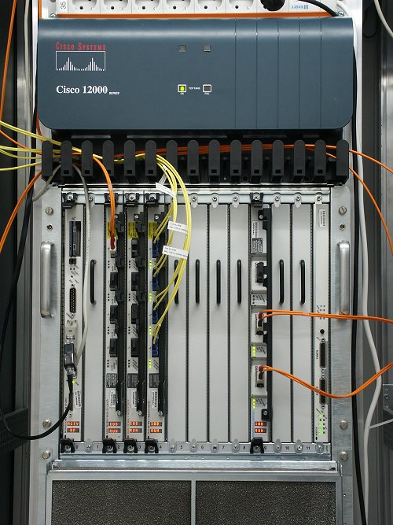
What’s in a data center?
Source: 1&1
Massive networking

Slide 14
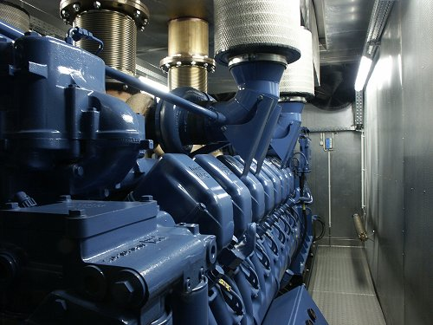
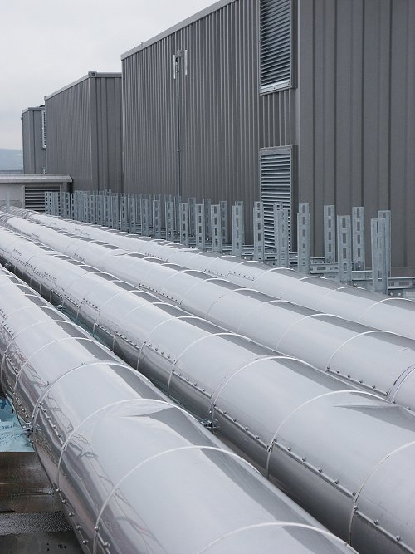
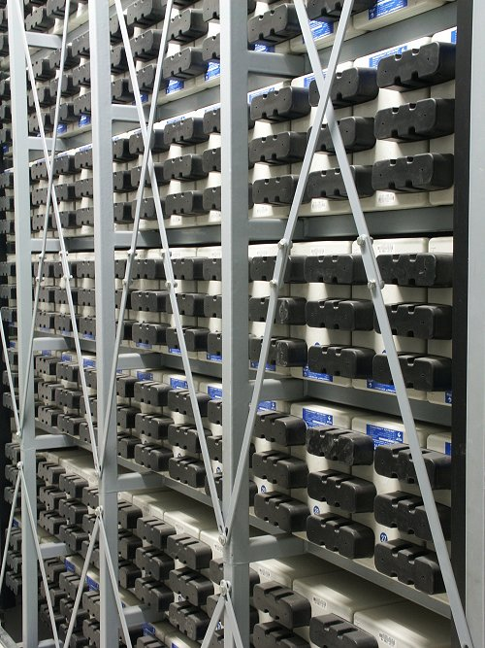
What’s in a data center?
Source: 1&1
Emergency power supplies

Slide 15
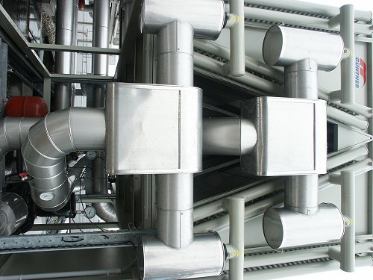
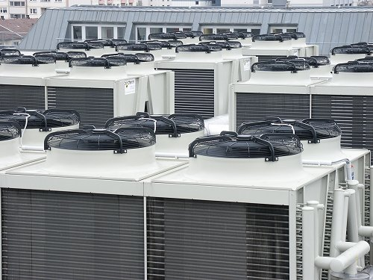
What’s in a data center?
Source: 1&1
Massive cooling

Slide 16
Energy matters!
Company | Servers | Electricity | Cost
eBay | 16K | ~0.6*10⁵ MWh | ~$3.7M/yr
Akamai | 40K | ~1.7*10⁵ MWh | ~$10M/yr
Rackspace | 50K | ~2*10⁵ MWh | ~$12M/yr
Microsoft | >200K | >6*10⁵ MWh | >$36M/yr
Google | >500K | >6.3*10⁵ MWh | >$38M/yr
USA (2006)
10.9M
610*10⁵ MWh
$4.5B/yr
Source: Qureshi et al., SIGCOMM 2009
Data centers consume a lot of energy
Makes sense to build them near sources of cheap electricity
Example: Price per KWh is 3.6ct in Idaho (near hydroelectric power), 10ct in California (long distance transmission), 18ct in Hawaii (must ship fuel)
Most of this is converted into heat → Cooling is a big issue!

Slide 17

Scaling up
PC
Server
Cluster
Data center
Network of data centers
What if even a data center is not big enough?
Build additional data centers
Where? How many?

Slide 18
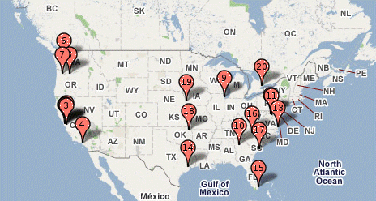
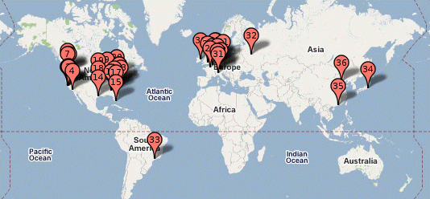
Global distribution
Data centers are often globally distributed
Example above: Google data center locations (inferred)
Why?
Need to be close to users (physics!)
Cheaper resources
Protection against failures

Slide 19
Cloud computing
Computing at scale
The need for scalability; scale of current services
Scaling up: From PCs to data centers
Problems with 'classical' scaling techniques
Utility computing and cloud computing
What are utility computing and cloud computing?
What kinds of clouds exist today?
What kinds of applications run on the cloud?

Slide 20
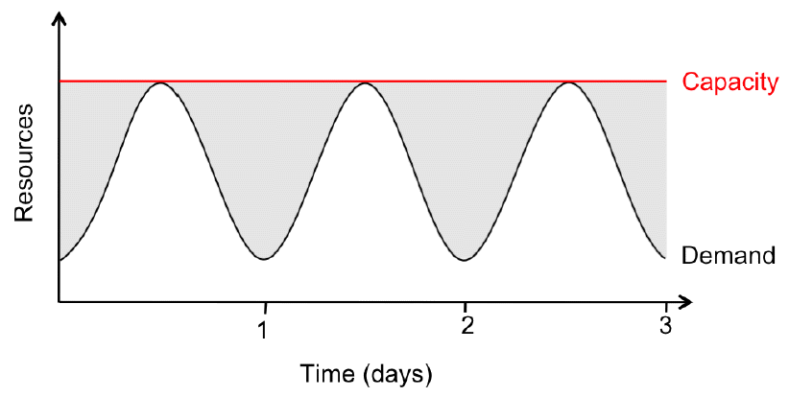
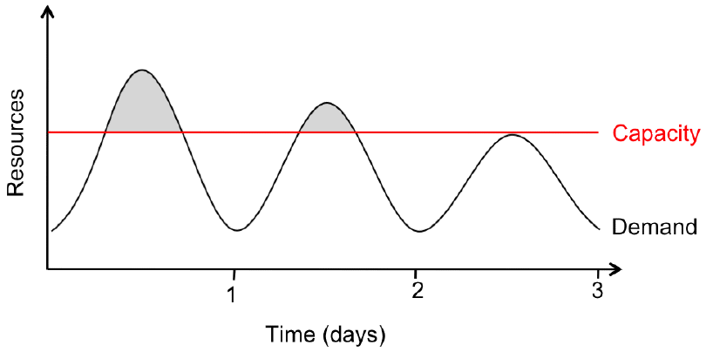
Problem #1: Difficult to dimension
Jobs cannot be completed
Dissatisfied customers leave
2x-10x
Provisioning for the peak load
Provisioning below the peak
Problem: Load can vary considerably
Peak load can exceed average load by factor 2x-10x [Why?]
But: Few users deliberately provision for less than the peak
Result: Server utilization in existing data centers ~5%-20%!!
Dilemma: Waste resources or lose customers!

Slide 21
Problem #2: Expensive
Need to invest many $$$ in hardware
Even a small cluster can easily cost $100,000
Microsoft recently invested $499 million in a single data center
Need expertise
Planning and setting up a large cluster is highly nontrivial
Cluster may require special software, etc.
Need maintenance
Someone needs to replace faulty hardware, install software upgrades, maintain user accounts, ...

Slide 22
Problem #3: Difficult to scale
Scaling up is difficult
Need to order new machines, install them, integrate with existing cluster - can take months!
Large scaling factors may require major redesign, e.g., new storage system, new interconnect, new building (!)
Scaling down is difficult
What to do with superfluous hardware?
Server idle power is about 60% of peak → Energy is consumed even when no work is being done
Many fixed costs, such as construction

Slide 23
Summary: Computing at scale
Modern applications require huge amounts of processing and data
Measured in petabytes, millions of users, billions of objects
Need special hardware, algorithms, tools to work at this scale
Clusters and data centers can provide the resources we need
Main difference: Scale (room-sized vs. building-sized)
Special hardware; power and cooling are big concerns
Clusters and data centers are not perfect
Difficult to dimension; expensive; difficult to scale

Slide 24
Cloud computing
Computing at scale
The need for scalability; scale of current services
Scaling up: From PCs to data centers
Problems with 'classical' scaling techniques
Utility computing and cloud computing
What are utility computing and cloud computing?
What kinds of clouds exist today?
What kinds of applications run on the cloud?

Slide 25
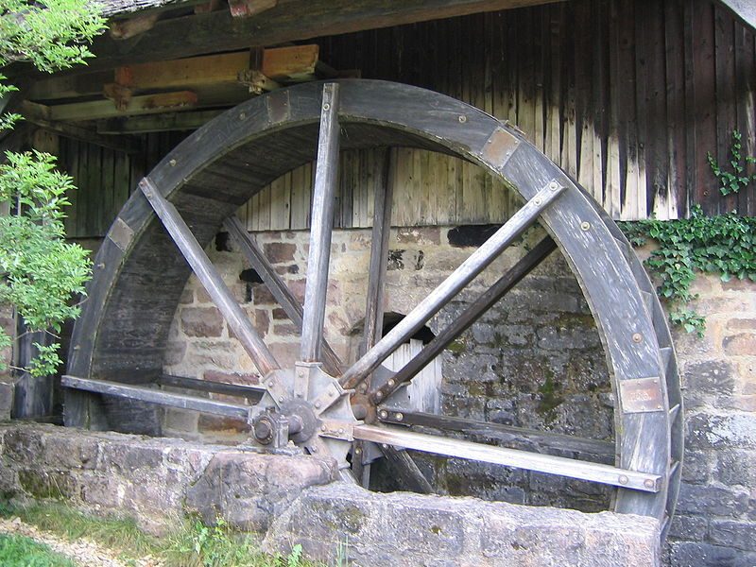
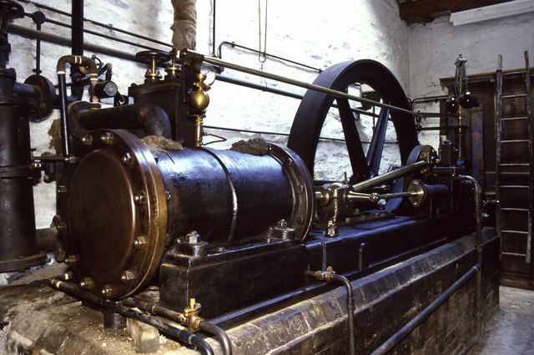
The power plant analogy
Steam engine at Stott Park Bobbin Mill
Waterwheel at the Neuhausen ob Eck Open-Air Museum
It used to be that everyone had their own power source
Challenges are similar to the cluster: Needs large up-front investment, expertise to operate, difficult to scale up/down...

Slide 26
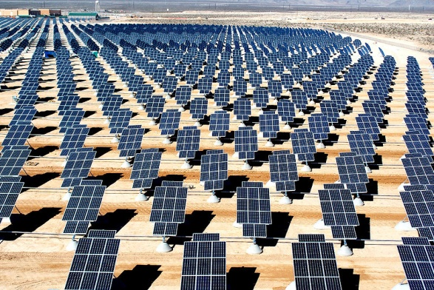
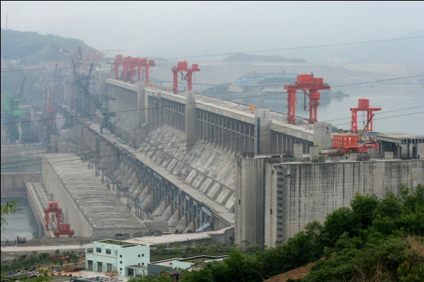
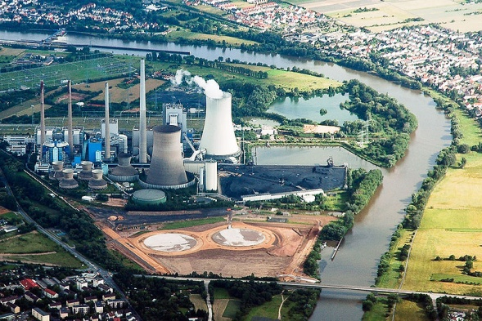
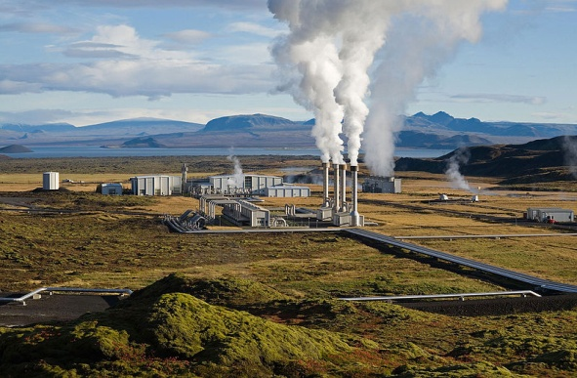
Scaling the power plant
Then people started to build large, centralized power plants with very large capacity...

Slide 27
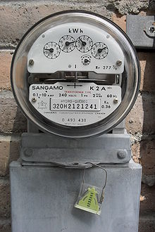
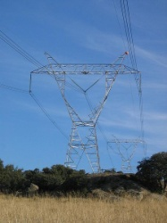
Metered usage model
Power source
Network
Metering device
Customer
Power plants are connected to customers by a network
Usage is metered, and everyone (basically) pays only for what they actually use

Slide 28

Why is this a good thing?
Electricity
Computing
Cheaper to run one big data center than many small ones
High utilization!
No investment in data center; pay-as-you-go model
Thousands of computers available on demand; add more within seconds
Economies of scale
Cheaper to run one big power plant than many small ones
Statistical multiplexing
High utilization!
No up-front commitment
No investment in generator; pay-as-you-go model
Scalability
Thousands of kilowatts available on demand; add more within seconds

Slide 29
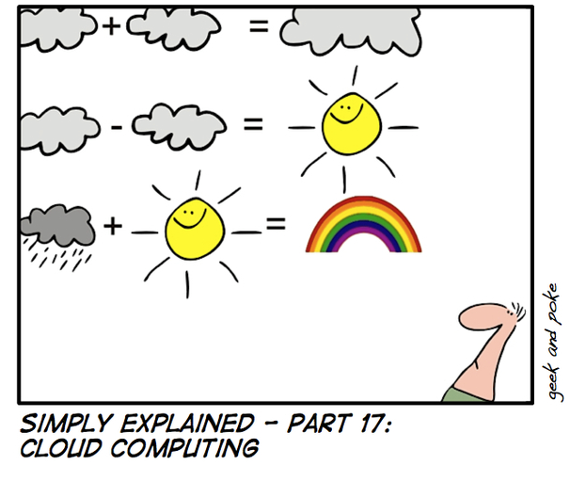
What is cloud computing?
http://geekandpoke.typepad.com/geekandpoke/images/2008/05/16/se17.jpg

Slide 30
What is cloud computing?
The interesting thing about Cloud Computing is that we've redefined Cloud Computing to include everything that we already do.... I don't understand what we would do differently in the light of Cloud Computing other than change the wording of some of our ads. Larry Ellison, quoted in the Wall Street Journal, September 26, 2008
A lot of people are jumping on the [cloud] bandwagon, but I have not heard two people say the same thing about it. There are multiple definitions out there of "the cloud". Andy Isherwood, quoted in ZDnet News, December 11, 2008

Slide 31
So what is it, really?
According to NIST:
Essential characteristics:
On-demand self service
Broad network access
Resource pooling
Rapid elasticity
Measured service
Cloud computing is a model for enabling convenient, on-demand network access to a shared pool of configurable computing resources (e.g., networks, servers, storage, applications, and services) that can be rapidly provisioned and released with minimal management effort or service provider interaction

Slide 32
Other terms you may have heard
Utility computing
The service being sold by a cloud
Focuses on the business model (pay-as-you-go), similar to classical utility companies
The Web
The Internet’s information sharing model
Some web services run on clouds, but not all
The Internet
A network of networks
Used by the web; connects (most) clouds to their customers

Slide 33
Everything as a Service
What kind of service does the cloud provide?
Does it offer an entire application, or just resources?
If resources, what kind / level of abstraction?
Three types commonly distinguished:
Software as a service (SaaS)
Analogy: Restaurant. Prepares & serves entire meal, does the dishes, ...
Platform as a service (PaaS)
Analogy: Take-out food. Prepares meal, but does not serve it
Infrastructure as a service (IaaS)
Analogy: Grocery store. Provides raw ingredients
Other *aaS types have been defined, but are less common
Desktop, DB, Communication, Network, Monitoring, …

Slide 34




Software as a Service (SaaS)
User
Application
Middleware
Hardware
Cloud provider
Cloud provides an entire application
Word processor, spreadsheet, CRM software, calendar...
Customer pays cloud provider
Example: Google Apps, Salesforce.com, Concur, Doodle

Slide 35

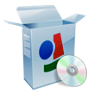

Platform as a Service (PaaS)
SaaS provider
User
Application
Middleware
Hardware
Cloud provider
Cloud provides middleware/infrastructure
For example, Microsoft Common Language Runtime (CLR)
Customer pays SaaS provider for the service; SaaS provider pays the cloud for the infrastructure
Example: Windows Azure, Google App Engine, Heroku

Slide 36

Infrastructure as a Service (IaaS)
SaaS provider
User
Application
Middleware
Hardware
Cloud provider
Cloud provides raw computing resources
Virtual machine, blade server, storage, network, ...
Customer pays SaaS provider for the service; SaaS provider pays the cloud for the resources
Examples: Amazon Web Services, DigitalOcean, Joyent

Slide 37





Private/hybrid/community clouds
Company A
Company B
Public
Community
Private
Who can become a customer of the cloud?
Public cloud: Commercial service; open to (almost) anyone Example: Amazon AWS, Microsoft Azure, Google App Engine
Community cloud: Shared by several similar organizations. Example: Google’s “Gov Cloud”
Private cloud: Shared within a single organization. Example: Internal datacenter of a large company.

Slide 38
Summary: Utility/cloud computing
Why is cloud computing attractive?
Analogy to 'classical' utilities (electricity, water, ...)
No up-front investment (pay-as-you-go model)
Low price due to economies of scale
Elasticity: can quickly scale up/down as demand varies
Different types of clouds
SaaS, PaaS, IaaS; public/private/community clouds
What runs on the cloud?
Many potential applications: Application hosting, backup/storage, scientific computing, content delivery, ...

Slide 39
Examples of cloud applications
Application hosting
Backup and Storage
Content delivery
E-commerce
High-performance computing
Media hosting
On-demand workforce
Search engines
Web hosting
If interested, glance through http://aws.amazon.com/solutions/case-studies/ for a list of many use cases

Slide 40

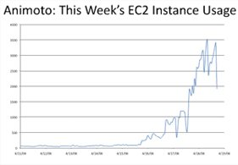
Case study:
Animoto: Lets users create videos from their own photos/music
Auto-edits photos and aligns them with the music, so it "looks good"
Built using Amazon EC2+S3+SQS
Released a Facebook app in mid-April 2008
More than 750,000 people signed up within 3 days
EC2 usage went from 50 machines to 3,500 (x70 scalability!)
http://animoto.com/blog/company/amazon-com-ceo-jeff-bezos-on-animoto/
Source: Jeff Bezos' talk at Stanford on 4/19/08
http://aws.amazon.com/solutions/case-studies/animoto/

Slide 41

Case study:
Novartis Institutes for Biomedical Research is focused on the drug discovery phase of the ~10 year / $1 billion drug development process
In 2013, NIBR ran a project to screen 10 M compounds against a common cancer target
Compute requirements >> internal capacity / $
The project ran across 10,500 EC2 Spot instances (~87,000 cores) for $4,232 in 9 hours
Equiv. of 39 years of computational chemistry
http://aws.amazon.com/solutions/case-studies/novartis/

Slide 42
Is the cloud good for everything?
No.
Sometimes it is problematic
Auditability requirements
Legislative frameworks
Example: Personal data privacy
EU Data Protection law
Example: Processing medical records (US)
HIPAA (Health Insurance Portability and Accountability Act) privacy and security rule

Slide 43
Summary: Cloud applications
Clouds are good for many things...
Applications that involve large amounts of computation, storage, bandwidth
Especially when lots of resources are needed quickly (Novartis example) or load varies rapidly (Animoto example)
... but not for all things
and might not be the cheapest solution either

Slide 44
Today’s outline
Cloud computing
Virtualization
What’s really cloud computing?

Slide 45

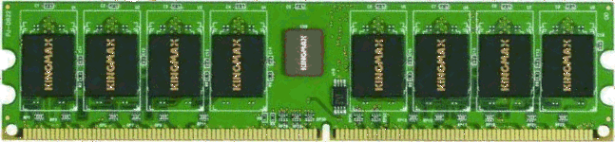


How clouds work?
Bob
Charlie
Alice
Physical machine
Daniel
Suppose Alice has a machine with 4 CPUs and 8 GB of memory, and three customers:
Bob wants a machine with 1 CPU and 3GB of memory
Charlie wants 2 CPUs and 1GB of memory
Daniel wants 1 CPU and 4GB of memory
What should Alice do?

Slide 46




Virtualization is key enabler
Bob
Virtual machine monitor
Charlie
Alice
Physical machine
Virtual machines
Daniel
Alice can sell each customer a virtual machine (VM) with the requested resources
From each customer’s perspective, it appears as if they had a physical machine all by themselves (isolation)

Slide 47
Virtualization
“a technique for hiding the physical characteristics of computing resources from the way in which other systems, applications, or end users interact with those resources. This includes making a single physical resource appear to function as multiple logical resources; or it can include making multiple physical resources appear as a single logical resource”

Slide 48
The idea of Virtualization: from 1960’s
IBM VM/370 – A VMM for IBM mainframe
Multiple OS environments on expensive hardware
Desirable when few machine around
Popular research idea in 1960s and 1970s
Entire conferences on virtual machine monitors
Hardware/VMM/OS designed together
Allowed multiple users to share a batch oriented system
Interest died out in the 1980s and 1990s
Hardware got more cheaper
Operating systems got more powerful (e.g. multi-user)

Slide 49
A Return to Virtual Machines
Disco: Stanford research project (SOSP ’97)
Run commodity OSes on scalable multiprocessors
Focus on high-end: NUMA, MIPS, IRIX
Commercial virtual machines for x86 architecture
VMware Workstation (now EMC) (1999-)
Connectix VirtualPC (now Microsoft)
Research virtual machines for x86 architecture
Xen (SOSP ’03)
plex86
OS-level virtualization
FreeBSD Jails, User-mode-linux, UMLinux
Notes:
The DISCO project eventually formed the early code of VMWARE.. (?)
Major change that happened was that processor capabilities became so fast that virtualization overheads could be reduced.

Slide 50
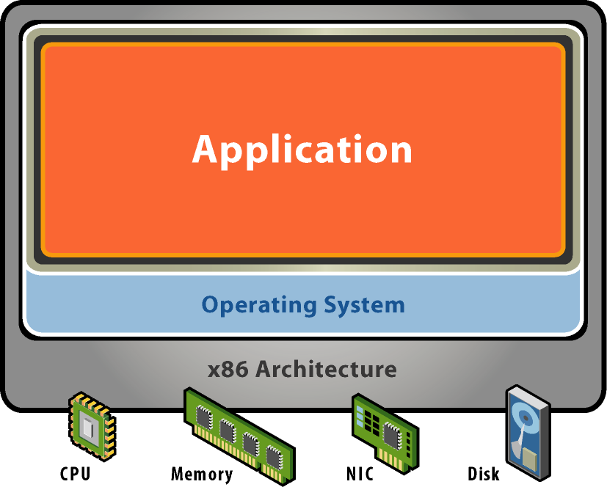
Starting Point: A Physical Machine
Physical Hardware
Processors, memory, chipset, I/O devices, etc.
Resources often grossly underutilized
Software
Tightly coupled to physical hardware
Single active OS instance
OS controls hardware

Slide 51
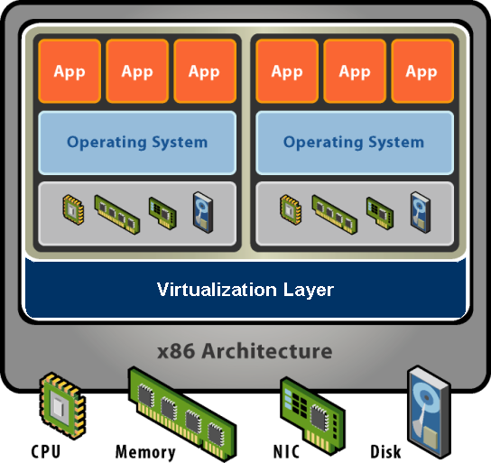
What is a Virtual Machine?
Software Abstraction
Behaves like hardware
Encapsulates all OS and application state
Virtualization Layer
Extra level of indirection
Decouples hardware, OS
Enforces isolation
Multiplexes physical hardware across VMs
Virtual Machine Monitor or Hypervisor
Notes:
Virtualization can be defined many ways. I will try to define it formally and also define it by giving a few examples. However loosely, virtualization is the addition of a software layer (the virtual machine monitor) between the hardware and the existing software that exports an interface at the same level as the underlying hardware.
In the strictest case the exported interface is the exact same as the underlying hardware and the virtual machine monitor provides no functionality except multiplexing the hardware among multiple VMs. This was largely the case in the old IBM VM/360 systems.
However the layer really can export a different hardware interface as the case in cross-ISA emulators. Also the layer can provide additional functionality not present in the operating system.
You can think of virtualization as the addition of a layer of software that can run the original software with little or no changes.

Slide 52
Virtualization Properties, Features
Isolation
Fault isolation
Performance isolation (+ software isolation, …)
Encapsulation
Cleanly capture all VM state
Enables VM snapshots, clones
Portability
Independent of physical hardware
Enables migration of live, running VMs (freeze, suspend,…)
Interposition
Transformations on instructions, memory, I/O
Enables transparent resource overcommitment, encryption, compression, replication …
Notes:
Virtualization has three main properties that give rise to all its applications.
Isolation
First, virtualization provides isolation. Isolation is key for many applications and comes in several flavors.
Fault Isolation. If one virtual machine contains a buggy operating system, that OS can start scribbling all over physical memory. These wild rights must be contained within the VM boundaries.
Performance Isolation. Ideally VMs performance would be independent of the activity going-on on the hardware. This must be accomplished by smart scheduling and resource allocation policies in the monitor.
Software Isolation. Most of the issues with computers today are complex software configurations. DLL hell on PCs, operating system and library versions, viruses, and other security threats. VMs are naturally isolated for each other by running in separate software environments.
Encapsulation
Encapsulation is the property that all VM state can be described and recorded simply. The VM state is basically the dynamic memory, static memory, and the register state of the CPU and devices. These items typically have a simple layout and are easy to describe. We can checkpoint a VM by writing out these items to a few files. The VM can be moved and copied by moving these files around. You can think about this as similar to doing a backup at the block level vs. doing a backup by recording all the packages, configuration and data files that encompass a file system.
Interposition
At some level all access to the hardware passes through the virtual machine monitor first. This gives the monitor a chance to operate on these accesses. The best example of this is encrypting all data written to a disk. The advantage of this is that it does it without the knowledge of the OS.
Why not in the OS?
This brings up a good point. Why not do these things in the OS. By splitting up the system this way the OS functions more like a large application library. The VMM functions more like a smart set of device drivers. This is a nice split and can simplify overall system design. It also provides a natural administration boundary. However the monitor is often at a disadvantage because it does not have the same insight into what’s happening as the OS has. For example, the OS knows the distinction between data and metadata when implementing an encrypted file system. So there is a tradeoff there.
Expanded capabilities. Want to use one machine to support multiple OS’s simultaneously. E.g., Parallels program makes it possible to run Windows applications on Macintosh. Does this by creating a VMM with MacOS as host, and Windows (or Linux) OS as guest. Can be done efficiently partly because both MacOS & Windows run on x86, so can directly execute most of the Windows & application code.
Resource sharing. Want to schedule many different programs onto a collection of machines, while providing high degree of isolation between them. Example: Amazon Web Services. Companies can rent virtualized machines by the hour. Use to run large data centers. Advantage of renting vs. buying: can dynamically change number of machines according to load, and let others deal with system administration. Much cheaper than buying & operating enough machines to meet peak load: rely on averages, and cost / CPU less than purchase & operate cost. (This was the original motivation for virtualization. IBM had big mainframe computers. Wanted to have multiple clients, each using OS of its choice, on single machine.)
Security. Runs user program within virtual machine that allows incoming network connection, but no outgoing one. Virtualization makes it impossible for program to modify any files or initiate network connections.
Flexibility. Can migrate complete "system" from one machine to another, including the OS and all applications running on it.
Testing / debugging. E.g., Jiri Simsa’s dBug program. Runs many tests on threaded program to look for concurrency bug. Each time, reloads image of machine’s starting point and then traces through new test sequence. VM provides simple way to checkpoint entire machine state and restart from saved state.

Slide 53
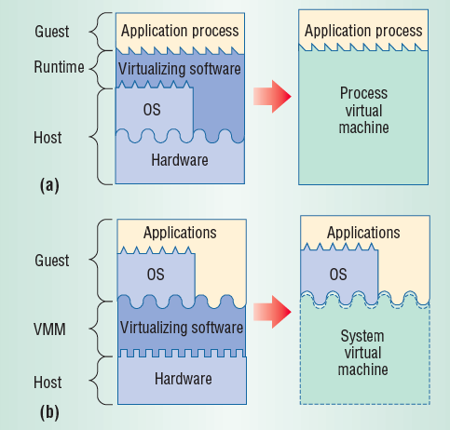
Types of Virtualization
Process Virtualization
Language-level Java, .NET, Smalltalk
OS-level processes, Solaris Zones, BSD Jails, Docker Containers
Cross-ISA emulation Apple 68K-PPC-x86
System Virtualization
VMware Workstation, Microsoft VPC, Parallels
VMware ESX, Xen, Microsoft Hyper-V
Notes:
Virtual systems
Abstract physical components/details using logical objects
Dynamically bind logical objects to physical configurations
We will mostly be focusing on “System Virtualization” but its useful to talk about the other forms of virtualization you are familiar with.

Slide 54
Language Level Virtualization
not-really-virtualization but using same techniques, providing similar features
Programming language is designed to run within custom-built virtualized environment (e.g. Oracle JVM)
Virtualization is defined as providing APIs that define a set of features made available to a language and programs written in that language to provide an improved execution environment
JVM compiled to run on many systems
Programs written in Java run in the JVM no matter the underlying system
Similar to interpreted languages

Slide 55
Types of VMs – Emulation
Another (older) way for running one OS on a different OS
Virtualization requires underlying CPU to be same as guest was compiled for while Emulation allows guest to run on different CPU
Need to translate all guest instructions from guest CPU to native CPU
Emulation, not virtualization
Useful when host and guest have different processor architectures
Company replacing outdated servers with new servers containing different CPU architecture, but still want to run old applications
Performance challenge – orders of magnitude slower than native code
New machines faster than older machines so can reduce slowdown
Where do you think it is used still?
Very popular – especially in gaming to emulate old consoles

Slide 56
VMs – Application Containers
Some goals of virtualization are segregation of apps, performance and resource management, easy start, stop, move, and management of them
Can do those things without full-fledged virtualization
If applications compiled for the host operating system, don’t need full virtualization to meet these goals
Containers / zones for example create virtual layer between OS and apps
Only one kernel running – host OS
OS and devices are virtualized, providing resources within zone with impression that they are only processes on system
Each zone has its own applications; networking stack, addresses, and ports; user accounts, etc
CPU and memory resources divided between zones
Zone can have its own scheduler to use those resources
Notes:
What’s the tradeoff? Less isolation than a fully virtualized system.
Containers also sometimes called lightweight virtualization. A company that has become really famous is Docker.

Slide 57
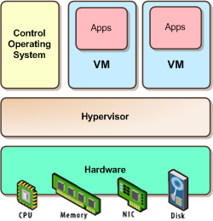
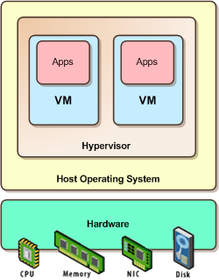
Types of System Virtualization
Native/Bare metal (Type 1)
Higher performance
ESX, Xen, HyperV
Hosted (Type 2)
Easier to install
Leverage host’s device drivers
VMware Workstation, Parallels
Attribution: http://itechthoughts.wordpress.com/tag/full-virtualization/

Slide 58
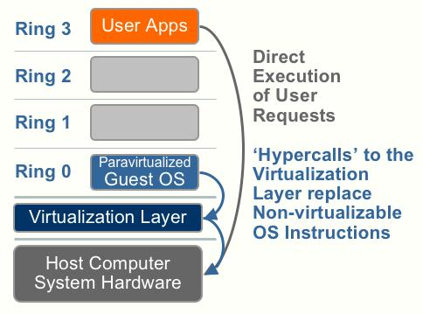
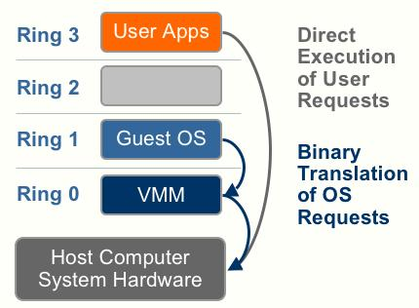
Types of Virtualization
Full virtualization (e.g. VMWare ESX)
Unmodified OS, virtualization is transparent to OS
VM looks exactly like a physical machine
Para virtualization (e.g. XEN)
OS modified to be virtualized,
Better performance at cost of transparency
Attribution http://forums.techarena.in/guides-tutorials/1104460.htm

Slide 59
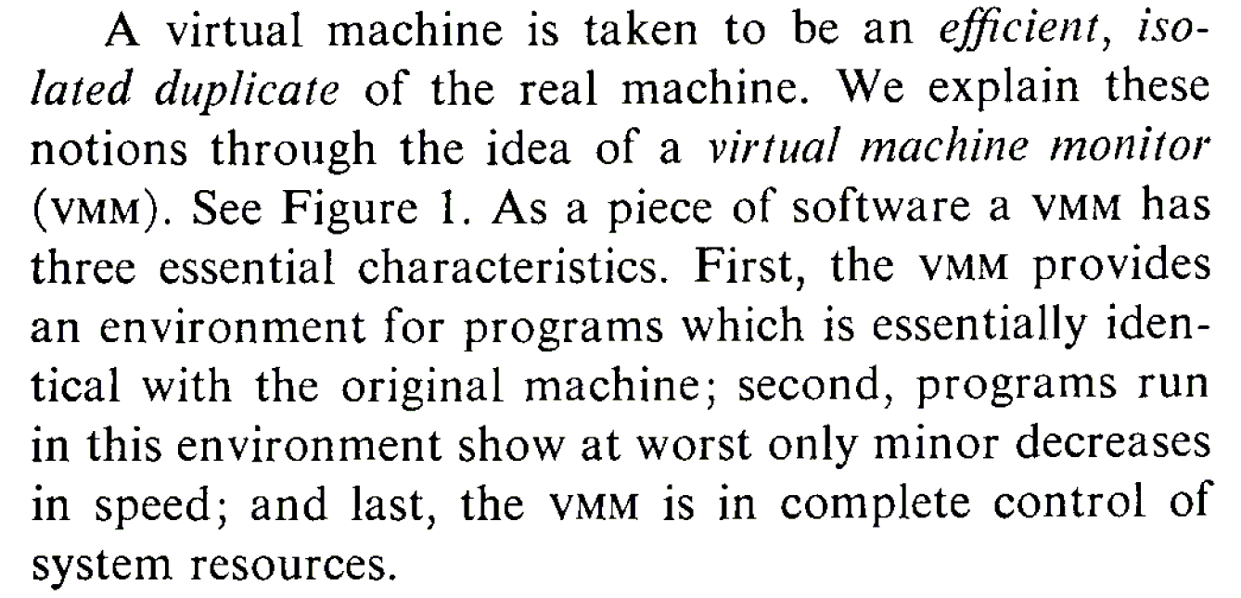
What is a Virtual Machine Monitor?
Classic Definition (Popek and Goldberg ’74)
VMM Properties
Equivalent execution: Programs running in the virtualized environment run identically to running natively
Performance: A statistically dominant subset of the instructions must be executed directly on the CPU
Safety and isolation: A VMM most completely control access to system resources

Slide 60
VMM Implementation Goals
Should efficiently virtualize the hardware
Provide illusion of multiple machines
Retain control of the physical machine
Which subsystems should be virtualized?
Processor => Processor Virtualization
Memory => Memory Virtualization
I/O Devices => I/O virtualization

Slide 61
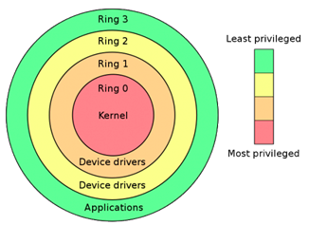
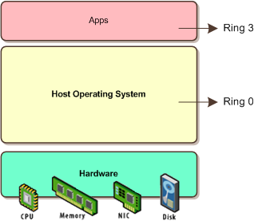
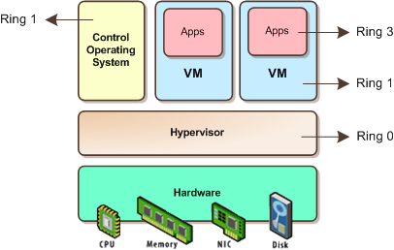
Processor Virtualization
An architecture is classically/strictly virtualizable if all its sensitive instructions (those that violate safety and encapsulation) are a subset of the privileged instructions.
all instructions either trap or execute identically
instructions that access privileged state trap
Attribution: http://itechthoughts.wordpress.com/tag/full-virtualization/
Notes:
Direct execution
Popek and Goldberg (1974)
- Sensitive instructions: only executed in kernel mode
- Privileged instructions: trap when run in user mode
- CPU architecture is virtualizable only if sensitive instructions are subset of privileged instructions
When guest OS runs a sensitive instruction, must trap to VMM so it maintains control

Slide 62
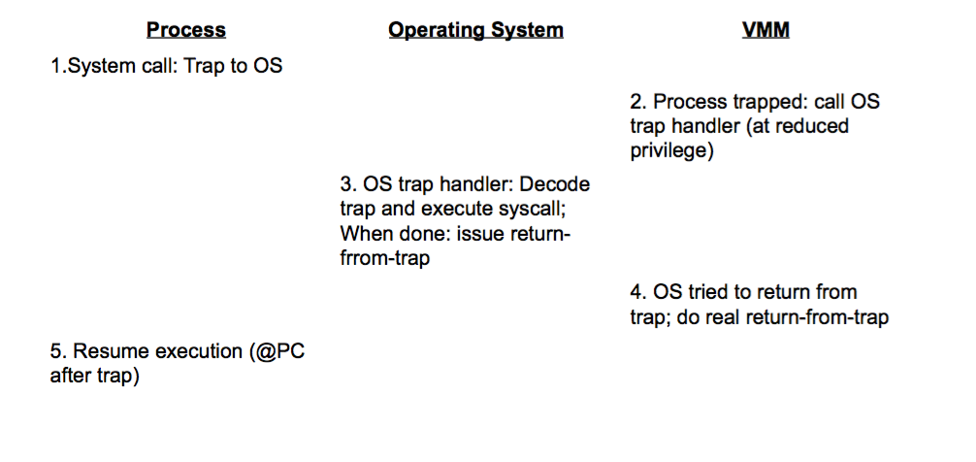
System Call Example
Run guest operating system deprivileged
All privileged instructions trap into VMM
VMM emulates instructions against virtual state e.g. disable virtual interrupts, not physical interrupts
Resume direct execution from next guest instruction

Slide 63
x86 Virtualization challenges
x86 not Classically Virtualizable
x86 ISA has instructions that RD/WR privileged state
…But which don’t trap in unprivileged mode
Example: POPF instruction
Pop top-of-stack into EFLAGS register
EFLAGS.IF bit privileged (interrupt enable flag)
POPF silently ignores attempts to alter EFLAGS.IF in unprivileged mode! => no trap to return control to VMM
Techniques to address inability to virtualize x86
Replace non-virtualizable instructions with easily Virtualized ones statically (Paravirtualization)
Perform Binary Translation (Full Virtualization)

Slide 64
Virtualizing the CPU
The VMM still need to multiplex VMs on CPUs
How could this be done?
# Physical CPUs more than #Virtual CPUs?
# Virtual CPUs more than #Physical CPUs?
Timeslice the VMs, each VM runs OS/Apps
Use simple CPU scheduler
Round robin, work-conserving (give extra to other VM)
Can oversubscribe and give more #VCPUs that actual

Slide 65
Virtualizing Memory
OS assumes that it has full control over memory
Management: Assumes it owns it all
Mapping: Assumes it can map any Virtual-> Physical
However, VMM partitions memory among VMs
VMM needs to assign hardware pages to VMs
VMM needs to control mapping for isolation
Cannot allow OS to map any Virtual => hardware page
Hardware-managed TLBs make this difficult
On TLB misses, the hardware walks page tables in mem
VMM needs to control access by OS to page tables
Notes:
- Cannot allow OS to map any Virtual => hardware page
- Thus, OS can only map to hardware page given by VMM

Slide 66


x86 Memory Management Primer
The processor operates with virtual addresses
Physical memory operates with physical addresses
x86 includes a hardware translation lookaside buffer (TLB)
Maps virtual to physical page addresses
x86 handles TLB misses in HW
HW walks the page tables => Inserts virtual to physical mapping

Slide 67
Shadow Page Tables
Three abstractions of memory
Machine: actual hardware memory (e.g. 2GB of DRAM)
Physical: abstraction of hardware memory, OS managed
E.g. VMM allocates 512 MB to a VM, the OS thinks the computer has 512 MB of contiguous physical memory
(Underlying machine memory may be discontiguous)
Virtual: virtual address space
Standard 2³² address space
In each VM, OS creates and manages page tables for its virtual address spaces without modification
But these page tables are not used by the MMU
Notes:
MMU = hardware memory managemeent unit

Slide 68


Three Abstractions of Memory
Native
Virtualized
Virtual Pages
Virtual Pages
Notes:
In a traditional system there are typically 2 address spaces – the virtual address space (VAS) and the physical address space (PAS). The OS and user processes run in the VAS. The OS manages the mapping from VAS to PAS through the use of the Memory Management Unit (MMU) provided in the processor. The OS maintains a page table that maps each page in the current VAS to a page in the PAS. Typically the OS will maintain one page table per user level process.

Slide 69
Shadow Page Tables (continued)
VMM creates and manages page tables that map virtual pages directly to machine pages
These tables are loaded into the MMU on a context switch
VMM page tables are the shadow page tables
VMM needs to keep its V => M tables consistent with changes made by OS to its V=>P tables
VMM maps OS page tables as read only
When OS writes to page tables, trap to VMM
VMM applies write to shadow table and OS table, returns
Also known as memory tracing
Again, more overhead...

Slide 70
Memory Management / Allocation
VMMs tend to have simple memory management
Static policy: VM gets 8GB at start
Dynamic adjustment is hard since OS cannot handle
No swapping to disk
More sophistication: Overcommit with balooning
Baloon driver runs inside OS => consume hardware pages
Baloon grows or shrinks (gives back mem to other VMs)
Even more sophistication: memory de-duplication
Identify pages that are shared across VMs!

Slide 71

Memory Ballooning
Notes:
Balloon memory manager/driver in the guest OS communicates with VMM and is told to allocate or deallocate memory to decrease or increase physical memory use of guest, causing guest OS to free or have more memory available

Slide 72

Page Sharing

Slide 73

Page Sharing

Slide 74

I/O Virtualization
Challenge: Lots of I/O devices
Problem: Writing device drivers for all I/O devices in the VMM layer is not a feasible option
Insight: Device driver already written for popular OSes
Solution: Present virtual I/O devices to guest VMs and channel I/O requests to a trusted host VM (popular OS)

Slide 75
Virtualizing I/O Devices
However, overall I/O is complicated for VMMs
Many short paths for I/O in OSes for performance
Better if hypervisor needs to do less for I/O for guests,
Possibilities include direct device access, DMA pass-through, direct interrupt delivery (need H/W support!)
Networking also complex as VMM and guests all need network access
VMM can bridge guest to network (direct access)
VMM can provide network address translation (NAT)
NAT address local to machine on which guest is running
VMM provides address translation to guest to hide its address

Slide 76
VM Storage Management
VMM provides both boot disk + other storage
Type 1 VMM – storage guest root disks and config information within file system provided by VMM as a disk image
Type 2 VMM – store as files in the host file system/OS
Example of supported operations:
Duplicate file (clone) -> create new guest
Move file to another system -> move guest
Convert formats: Physical-to-Virtual (P-to-V) and Virtual-to-Physical (V-to-P)
VMM also usually provides access to network attached storage (just networking) => live migration
Notes:
Physical-to-virtual (P-to-V) and convert native disk blocks into VMM format
Virtual-to-physical (V-to-P) convert from virtual format to native or disk format

Slide 77
OS Component – Live Migration
VMMs allow new functionality like live migration
Running guest OS can be moved between systems, without interrupting user access to the guest or its apps
Very useful for resource management, no downtime windows, etc
How does it work?

Slide 78
Live Migration of VMs
Notes:
Q1: what happens to my persistent state? (i.e. state on my hard drive or stuff that’s not in the main memory?) (Ans: network attached storage or NFS usually, don’t want to move all the hard drive state over the n/w!)
Q2: How do you ensure that the network parameters (IP, MAC) etc are all the same? How will other machines know where to contact me? (Answer: ARP updates, flat network, same virtual MAC address as before so things work as before).

Slide 79
OS Component – Live Migration
VMMs allow new functionality like live migration
Running guest OS can be moved between systems, without interrupting user access to the guest or its apps
Very useful for resource management, no downtime windows, etc
How does it work?
Source VMM connects to the target VMM
Target VMM creates a new guest (e.g. create a new VCPU, etc)
Source sends all read-only guest memory pages to the target
Source sends all RD/WR pages to the target, marking them clean
Source repeats step 4, as some pages may be modified => dirty
When cycle of steps 4 and 5 becomes very short, source VMM freezes guest, sends VCPU’s final state + other state details, sends final dirty pages, and tells target to start running the guest
Target acknowledges that guest running => source terminates guest

Slide 80
Summary: Virtualization
Resources (CPU, memory, …) are virtualized
VMM (Hypervisor) has translation tables that map requests for virtual resources to physical resources
Implementation must have low overheads
Types: full system vs para virtualization vs containers
different trade-offs
Properties: Isolation, Encapsulation, Portability, Interposition
Multiple VMs can time-share resources -> high utilization
VMs can be migrated -> balance load, handle planned maintenance, cope with failures
Key enabler of Cloud computing!

Slide 81
Today’s outline
Cloud computing
Virtualization
What’s really cloud computing?

Slide 82
Model 1
1
Traditional
$4000/user
(one time)
SW
$800/user/ year
Support
For large software companies (MS, SAP, Oracle) is a good model
Buy perpetual license, and upgrades, bug fixes, phone support
Notes:
BM: you buy the software from Microsoft, Oracle: perpuetual license / upgrade and update and the right to call
derivative price: 20% of the license price
very good business model
very high profit margin
large software companies: that model works really really well
Oracle 12 B out of 15 B

Slide 83
Model 2
1
Traditional
2
Open Source
$4000/user
(one time)
$0/user
SW
$800/user/ year
$1600/user/year
Support
Not as many success stories (biggest one probably RedHat)
But open source is fueling much success for cloud computing
Notes:
conceptually more than in model 1
1 success story: redhat network is one good example of this working
not many other examples of it

Slide 84
Management Costs
1
Traditional
$4000/user
(one time)
SW
$800/user/ year
Support
$16,000/user/year
($1300/user/year)
To manage the security, availability, performance, problems and change
Mgmt
Cost to manage software is 4x the purchase price per year
Notes:
cost of the software does not end with purchase
If I buy a CRM, HR , supply chain, all these applications; then I need to manage the security, availability, performance and change of the software
If you look at the budget of a CIO, 75% of the budget is fully allocated for the next year: all spent doing management
Rule of thumb: people spend 4 times the cost of the software to manage it
16000/user/year

Slide 85
Model 3
1
Traditional
2
Open Source
3
Outsourcing
$4000/user
(one time)
$0/user
$4000/user
(one time)
SW
$800/user/ year
$1600/user/year
$800/user /year
Support
Bid
<1300/user/month
Mgmt
At home / at customer
Outsourcing became popular in the ’90s as Internet got widespread
Cost reduction through low-cost labor is hard to sustain
Human error is #1 cause of computer system failures
Notes:
take over the datacenter or do it at my datacenter
@home or my @datacent
took over in late 90s.
why?
network got in place
2nd: cheap human
fundamental problem with the model: people are not going to work for 1/10th of the cost in another location
another flaw: why do computer system fail? #1 failure source is operator failure

Slide 86
Model 4
1
Traditional
2
Open Source
3
Outsourcing
4
Hybrid
$4000/user
(one time)
$0/user
$4000/user
(one time)
$4000/user
(one time)
SW
$800/user/ year
$1600/user/year
$800/user/ year
$800/user/ year
Support
Bid
<1300/user/month
$150/user/ month
Mgmt
At home / at customer
At home / at customer
How to decrease costs by 10x?
Standardization, specialization, repetition → in time automate
Notes:
manage at my place or your place: for $150 dollars
support: continuing refresh upgrade and right to calls them up: how do I use it? there is a bug and fix it
mgmt: security fixes, patch the reason this hybrid model can work:
standardization, specialization, repetition
standardize the stack: hardware, software (OS), how you manage security patches
then in time you can crush costs

Slide 87
Model 5
1
Traditional
2
Open Source
3
Outsourcing
4
Hybrid
5
Hybrid+
$4000/user
(one time)
$0/user
$4000/user
(one time)
$4000/user
(one time)
$300/user/ month
SW
$800/user/ year
$1600/user/year
$800/user/ year
$800/user/ year
Support
Bid
<1300/user/month
$150/user/ month
Mgmt
At home / at customer
At home / at customer
At home / at customer
Pure subscription model
Simply a change of the payment term compared to Model 4

Slide 88
Model 6
1
Traditional
2
Open Source
3
Outsourcing
4
Hybrid
5
Hybrid+
6
Cloud
$4000/user
(one time)
$0/user
$4000/user
(one time)
$4000/user
(one time)
$300/user/ month
<$100/user/month
SW
$800/user/ year
$1600/user/year
$800/user/ year
$800/user/ year
Support
Bid
<1300/user/month
$150/user/ month
Mgmt
At home / at customer
At home / at customer
At home / at customer
Software companies gone public since 2000 deliver Cloud services
10x cost reduction in exchange for higher degree of standardization
Notes:
delivered as a cloud service
every company that has gone public since 2000 is in model 6
you don't get to pick where it runs, when to patch it
in exchange for higher degree of automation, I can take the cost structure down

Slide 89
Model 7
1
Traditional
2
Open Source
3
Outsourcing
4
Hybrid
5
Hybrid+
6
Cloud
7
Internet
$4000/user
(one time)
$0/user
$4000/user
(one time)
$4000/user
(one time)
$300/user/ month
<$100/user/month
Ads
Transactions
Embedded
(<$10/user/month)
SW
$800/user/ year
$1600/user/year
$800/user/ year
$800/user/ year
Support
Bid
<1300/user/month
$150/user/ month
Mgmt
At home / at customer
At home / at customer
At home / at customer
No direct charge; monetization model is asymmetric
Software is paid through ads, transactions fees, …
Consumer apps have dramatically lower costs than enterprise apps
Notes:
Monetization model is asymmetric
you don't pay directly, you compensate with ads
most companies started in the past 10 years are in the 6th or 7th model
for business applications, the growth is happening in model 6

Slide 90
Cloud computing is a business model
AWS
us-west-2
prices
Compute
Per service hour
$0.16/hour
(averaged on instance sizes)
Storage
Per GB stored
SSD: $0.10 HDD: $0.05
GB/month

Slide 91
Serverless computing
Enter post VM and container based clouds
Cloud execution model in which cloud provider dynamically manages the allocation of machine resources
Developers don't have to worry about managing, provisioning and maintaining servers
Just write and deploy code on the cloud
It’s a form of PaaS but ricing is based on the actual amount of resources consumed by an application
AWS charges for compute power in 100 ms increments
Ultimately a new business model for the cloud

Slide 92
Next lecture topic:
Network file systems

